Slide 1
Twitch Data Campaign
Consent Based Data Collection on Twitch.tv

Slide 2
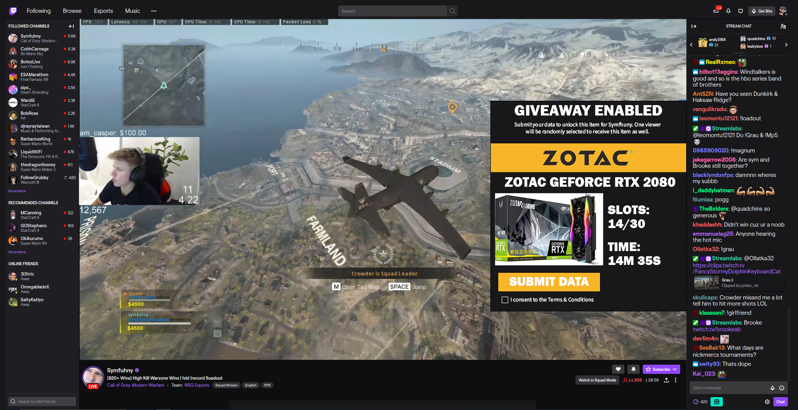
Twitch Extensions: Gateway to Gamers

Slide 3
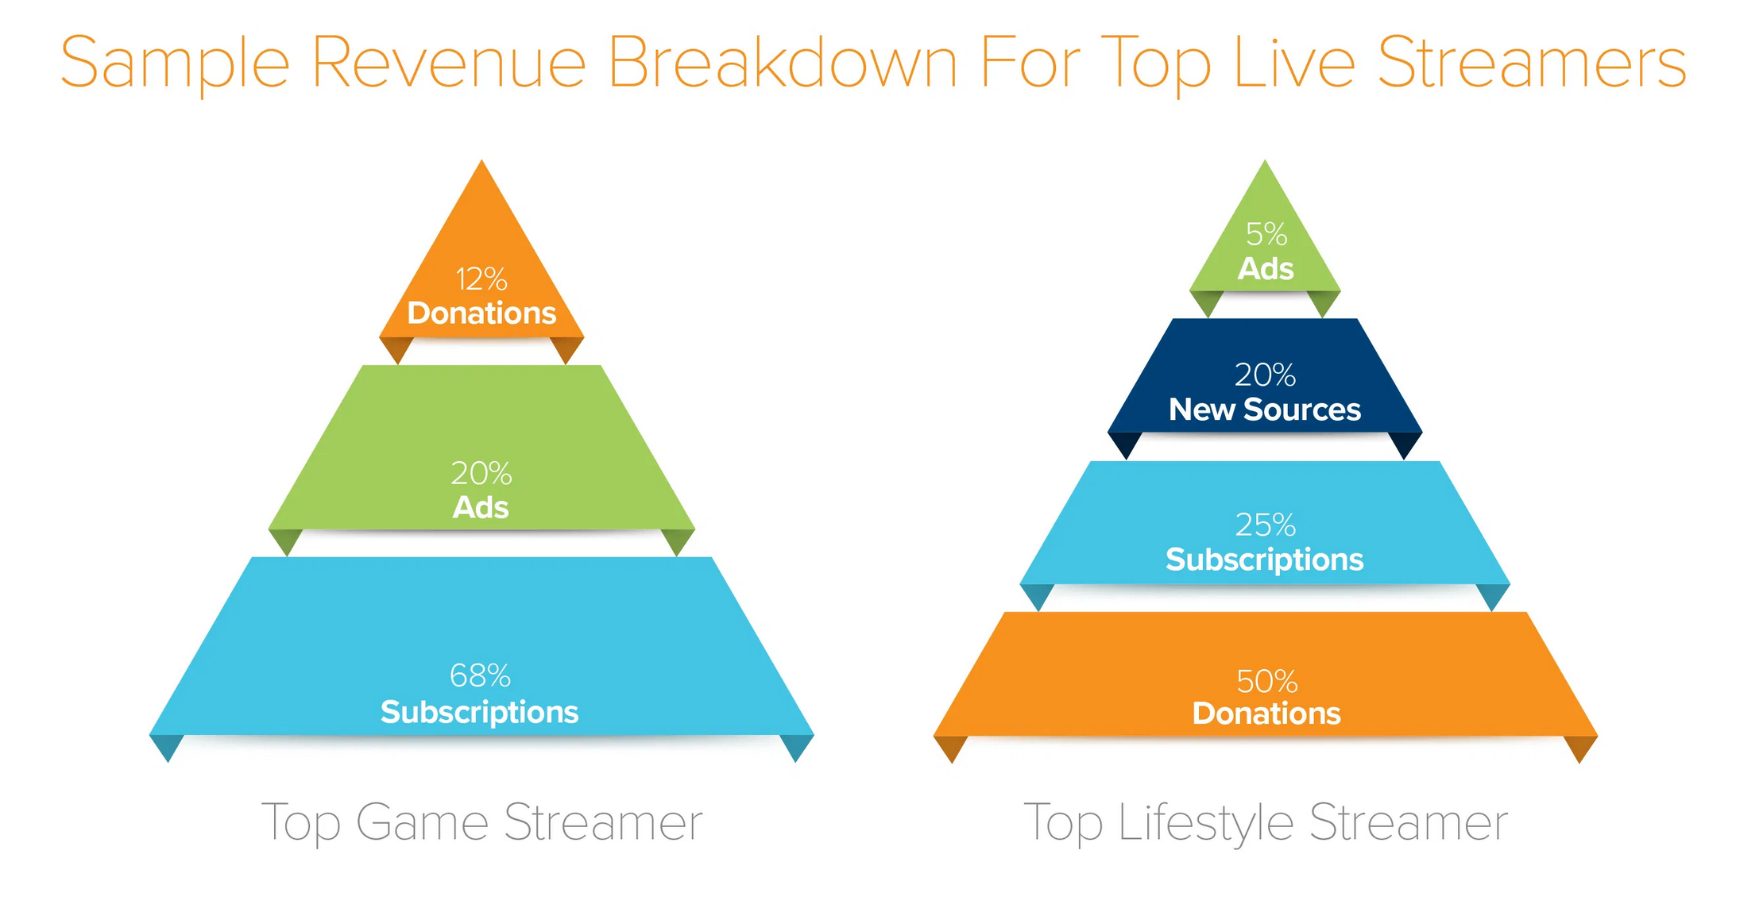
Influencer Incentivization
Streamers earn revenue from viewers in the form of subscriptions, ads, donations, and sponsorships.
This is a sample breakdown from a very successful streamer that earns $20k/month online.
Image source: Andreessen Horowitz.

Slide 4
Viewer Incentivization
Streamers need data for sponsorships.
By giving data to help their favorite streamers, viewers can be incentivized towards providing access to their Twitch information.
After the campaign is completed, streamers will receive access to the information collected from their audience.
This allows them to provide deeper analytics on their audiences to sponsors and improve their chances at earning additional sponsorships.
This can be gamified, and the type of data that the streamer receives could be expressed through the gamification.
Notes:
On the last point: an FPS gamer might receive data that is male and prefers FPS, thus creating a gun toting man for an avatar. On the other hand, an ASMR streamer that appeals broadly but skews towards women could be expressed as a female druid. Just spitballing here. These characters could potentially fight other characters, perhaps in an Ethereum style battle a la crypto kitties?

Slide 5
The Funnel
Influencers
Twitch streamers solicit their viewers to consent to data collection from Twitch, as well as the right for DataLucent to contact them in the future with additional offers, via a Twitch extension.
Once a critical mass is established, those viewers are contacted via email and Twitch chat to consent to a second round of incentivized data acquisition via DataLucent’s data tool.
Viewers
Data
Respondents

Slide 6
The Campaign
15 influencers with
3000+ avg. viewers per stream per month over two weeks gives exposure to 45k gamers or more during that period.
Influencers
For the purposes of this proof of concept, the goal of 5000 respondents has been set. A 33% conversion rate for sweepstakes was used as the baseline expectation for Twitch conversions, and 11.1% is the total estimated conversion rate from Influencers to Respondents. Real-world scenarios are likely to differ.
45K
viewers
Twitch Viewers
45k viewers per stream per month are solicited to submit their Twitch data. Given a 33% conversion rate…
33% conversion rate
15k users will submit their data, and be solicited for a second giveaway and directed to a DataLucent data collection app. Given a 33% conversion rate on this process…
Social Media Data Respondents
33% conversion rate
5,000 Total Respondents

